Slide 1
ServiceNow
Dynamic Schedule
Xuefei Zhao
04/21/2017

Slide 2
Problem & Suggested Algorithm optimization:
Problem to previous algorithm
“Unassign” low priority tasks may leads to exponential complexity
Optimized algorithm
Bin-packing (jobs : agencies = m : n, for compacted scheduling)
Proposed algorithm:
Algorithm | Time complexity | Space complexity | Efficiency*
Best Fit | O(nlogn + mlogn) | O(n) | ?
Next Fit | O(n) | O(1)
First Fit | O(mn) | O(1)
Worst Fit | O(nlogn + mlogn) | O(n)
*: the percentage of jobs that are properly assigned to agents
Notes:
Best fit: Assign the jobs into the agents that are the most full, but still has enough space for the jobs. Uses a Navigable TreeSet for the ceiling and flooring operations that it has.
First Fit: Assign job to the agent with smallest agent number and the ability to finish the job
Nest Fit: Assign the job in the last agent seen. If it does not fit there, then check the next agent after it and assign it there.
WorstFit: Assign the job into the "emptiest" agent among those with a smaller agent number than current agent. If not possible, check agent with larger agent numbers if there are two or more agents tied for emptiest, use the agent with a smaller agent number;

Slide 3
Flowchart of whole system
Task/Tasks
Asynchronous trigger of dynamic scheduling
Manual trigger of dynamic scheduling
Task found in pending dispatching
On the UI – chose task(s) in pending dispatching, active these tasks
Grouping: Machine learning
Location + skill
Task with immediate assignment request?
Yes
Identify the group(s)
Grouping: Machine learning Location + skill
No
Identify the group
For each group
Add task to the specified group batch
When a group is set to run
Machine learning: agent recommendation;
Optimized scheduling: bin-processing
Active all tasks within this group
Call dynamic scheduling for active tasks within specified group
MapReduce: distributed system for independent groups
Return assigned task(s)

Slide 4
Flowchart of dynamic scheduling
Task/Tasks within a group
Task time = task time + average commute time within this group
Order active tasks by work due date and then priority
Agents recommendation
Optimized scheduling
Score calculation for agents within group
The weight of each parameter is decided by Machine learning
For each task
Best Fit;
First Fit;
Next Fit;
Worst Fit
Recommend at most 5 agents to costumer
Assign the task to the first agent which has enough time to finish this task
Return assignment result

Slide 5
Problem & Suggested Algorithm optimization:
Algorithm | Time complexity | Space complexity | Efficiency*
Best Fit | O(nlogn + mlogn) | O(n) | Best, ~90%
Next Fit | O(n) | O(1) | Worst, ~0%
First Fit | O(mn) | O(1) | Good, ~ 40%
Worst Fit | O(nlogn + mlogn) | O(n) | Worst, ~ 10%
Algorithm | m = 1000, n = 500 |  | m = 10000, n = 5000 |  | m = 100000, n = 50000
 | Time | Efficiency | Time | Efficiency | Time | Efficiency
Best Fit | 0 | 89% | .02 | 95% | 0.10 | 95%
Next Fit | 0 | 0 | 0 | 0 | 0 | 0
First Fit | .02 | 37% | 0.15 | 43% | 20 | 44%
Worst Fit | 0 | 4% | 0 | 6% | 0.02 | 6%
*: the percentage of jobs that are properly assigned to agents

Slide 6
Open Source on Github:
https://github.com/rschmukler/agenda

Slide 7

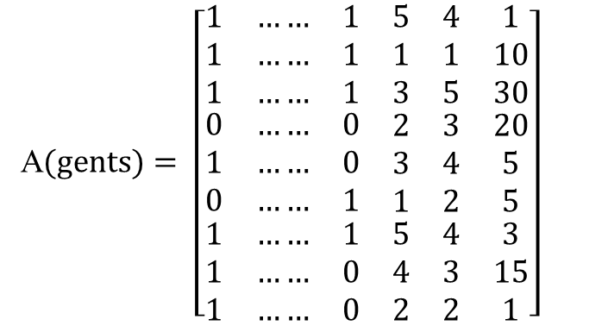

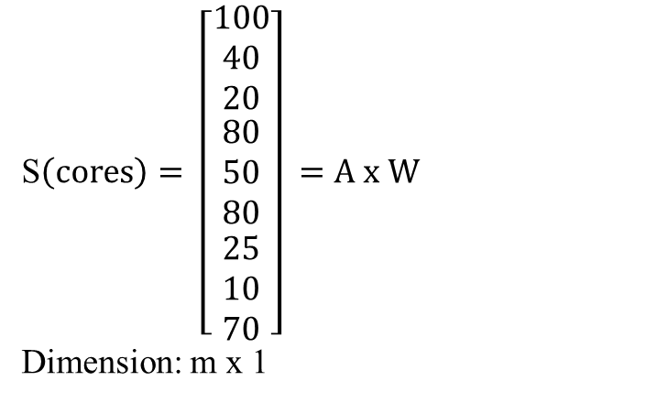
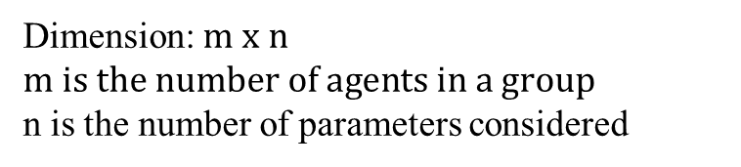
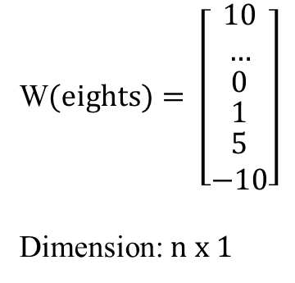

Machine learning: coefficients matrix
Slot availability
Agent level
Distance
A$(gents)= \left[\begin{matrix}\begin{matrix}\begin{matrix}1 & …… & 1 \\ 1 & …… & 1 \\ 1 & …… & 1\end{matrix} \\ \begin{matrix}0 & …… & 0 \\ 1 & …… & 0 \\ 0 & …… & 1\end{matrix}\end{matrix} & \begin{matrix}\begin{matrix}5 & 4 & 1 \\ 1 & 1 & 10 \\ 3 & 5 & 30\end{matrix} \\ \begin{matrix}2 & 3 & 20 \\ 3 & 4 & 5 \\ 1 & 2 & 5\end{matrix}\end{matrix} \\ \begin{matrix}1 & …… & 1 \\ 1 & …… & 0 \\ 1 & …… & 0\end{matrix} & \begin{matrix}5 & 4 & 3 \\ 4 & 3 & 15 \\ 2 & 2 & 1\end{matrix}\end{matrix}\right]$
Dimension: $m x n$ $m is the number of agents in a group$
n is the number of parameters considered
S$\left(cores\right)= \left[\begin{matrix}\begin{matrix}100 \\ 40 \\ 20\end{matrix} \\ \begin{matrix}\begin{matrix}80 \\ 50 \\ 80\end{matrix} \\ \begin{matrix}25 \\ 10 \\ 70\end{matrix}\end{matrix}\end{matrix}\right] =A x W$
Dimension: m x 1
W$(eights)= \left[\begin{matrix}\begin{matrix}10 \\ …\end{matrix} \\ \begin{matrix}0 \\ \begin{matrix}1 \\ \begin{matrix}5 \\ −10\end{matrix}\end{matrix}\end{matrix}\end{matrix}\right]$
Dimension: $n x 1$

Slide 8
Schematic diagram of the whole system
Worker Manager
Send requested workers’ information
Send change of workers’ cancellation
Job Manager
Send back jobs without suitable workers
Send final schedule to worker manager (worker with his assigned job)
Request some specific workers’ information
Send job cancellation
Small scale: directly sent to scheduler;
Large scale: separate into different queues based on department, job priority, etc
Scheduler (Library or Service)
Urgent job: check if there is suggested worker; if suggested worker is not available, find his college; preemption
find the workers have suitable skillset and availability (smaller distance to the job is preferred)
Common job: batch processing
binpacking (online), finish it with fewest worker, least time, least commute cost

Slide 9
Design of key component
Worker Manager
N-ary tree: workers
TreeNode: worker
name; id; skillset; available time; address; CurrentJobList; manager (parent node); subordinate (childnodes)
assignedJob (occupy worker’s available time by a task, add this job to worker’s currentJobList)
sendCancellation (in case sicks or other issues when the worker can not finish his jobs)
finishJob (send notification to jobManager, remove this job from worker’s currentJobList)
jobCancellation (no need to work on this job; retrieve the job from currentJobList, recover the corresponding time)

Slide 10
Design of key component
Manager
Worker Manager
w1
w7
w9
w2
w8
w3
w4
Group 1
w5
Group 3
w6
Group 2

Slide 11
Design of key component
Job
jobId; demandSkillSet; demandTime; jobAddress; assignedWorker; suggestedCadidates; jobPriority; jobStatus
assignJob(add suggested worker to assignedWorker and suggestedCadidates, status: finished);
jobCancellation(job removed for job queue; inform workManager)
reassignJob(the worker can not finish this job; this job need to be sent back to waiting queue or scheduler and reassigned; jobStatus: need reassign)
finishJob(job status: finished)
jobCategory(separate jobs to different categories and only search for workers good for this category)
Job Manager

Slide 12
Design of key component
checkSkillSet(if meet all demanded skills)
checkAvailability(if available at requested time)
dist(calculate the distance between worker and job, worker with smaller distance is preferred; based on zipcode or (longitude, latitude))
Schedule(streaming processing and/or batch processing)
Scheduler (Library)

